Slide 1


Engagement and Motivation in MOOCs
Stephen Downes
November 22, 2011

Slide 2

This is a discussion of issues, not a presentation of results.
Photo: http://bit.ly/v5sF7k

Slide 3
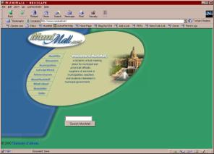
A long time ago, I developed and worked with an LMS. Then I built some online communities. Engagement was easy.
http://www.slideshare.net/Downes/munimall-a-review

Slide 4

More recently, I’ve worked with newsletters, social networks, and distributed networks. Engagement was assumed.
http://www.downes.ca/news/OLDaily.htm

Slide 5
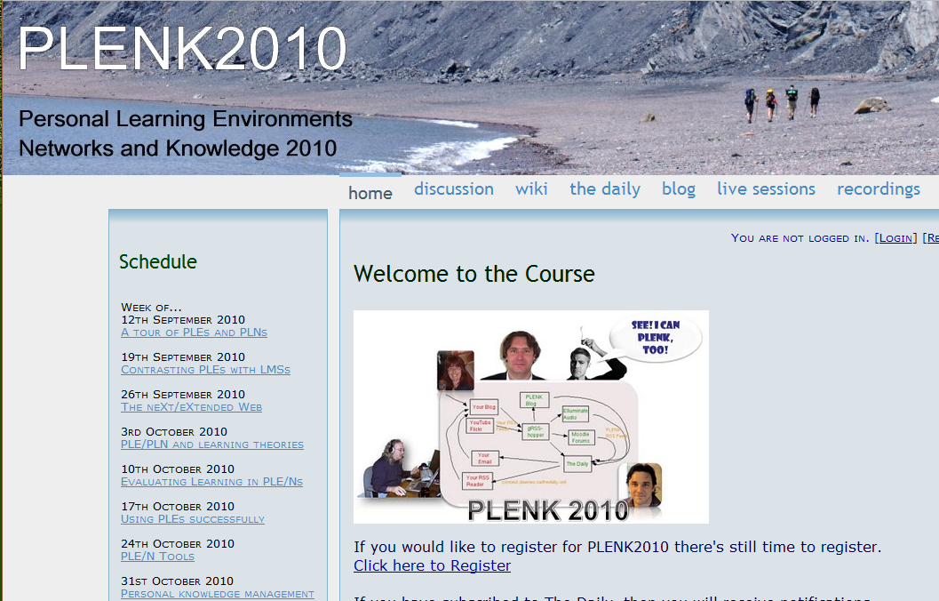
Even more recently, I’ve been working on MOOCs – Massive Open Online Courses. These create new expectations.
http://connect.downes.ca/

Slide 6
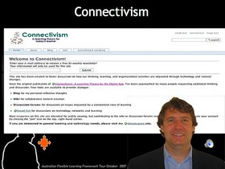
These aren’t typical courses – they are based on a connectivist pedagogy of learning through linkages and conversation
http://www.elearnspace.org/Articles/connectivism.htm

Slide 7

Learning isn’t a matter of acquiring facts, but rather the development of connections through engagement and interaction.
http://www.youtube.com/watch?v=eW3gMGqcZQc

Slide 8
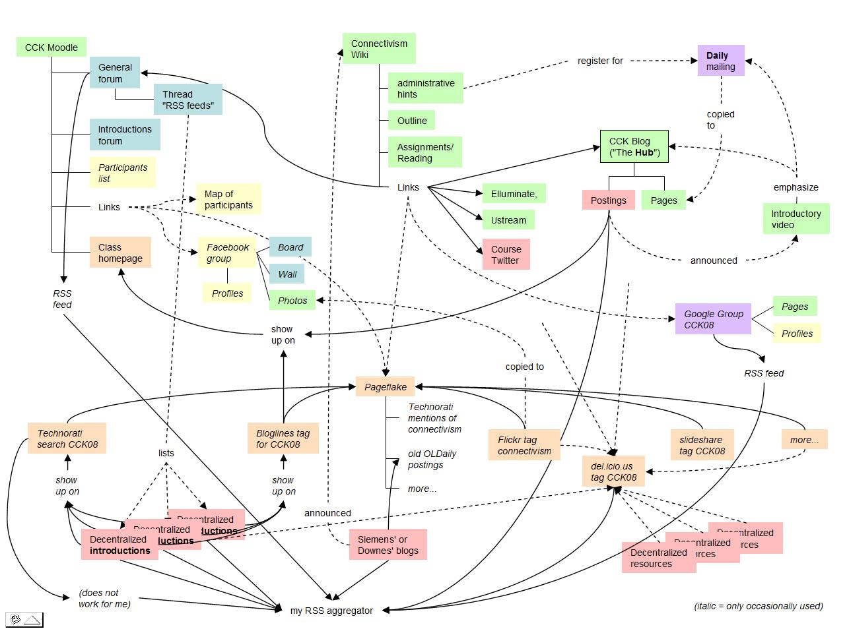
The structure of the course isn’t like a book or a narrative, but rather like a web.
http://bit.ly/vYgbwd

Slide 9
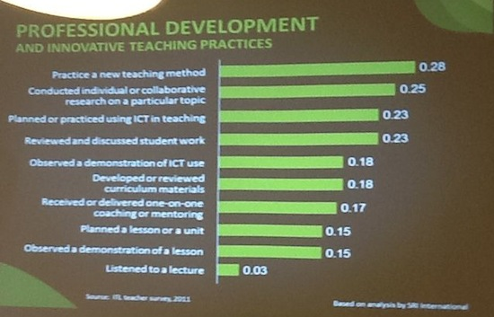
The idea is to learn through practice and reflection, becoming a knowing person by doing – the way we know people do learn.
http://dougpete.wordpress.com/2011/11/22/learn-ict/

Slide 10

We are currently offering a 30 week monster course called #Change11 with 2200 students
http://change.mooc.ca/

Slide 11
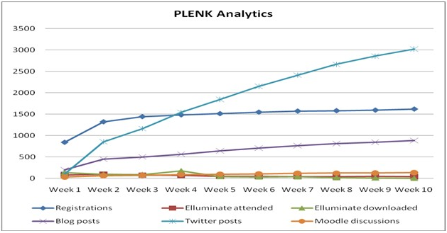
And we’re seeing the same sort of pattern we’ve seen in other connectivist courses.
http://www.irrodl.org/index.php/irrodl/article/view/882/1689

Slide 12
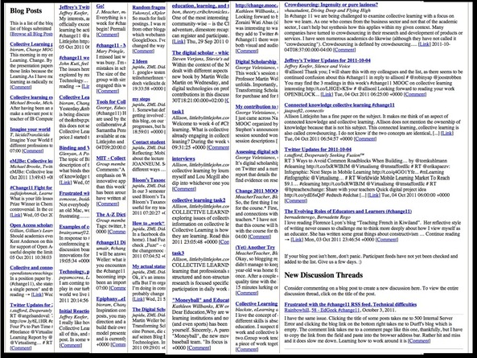
The decline can be dramatic.
http://erikduval.wordpress.com/2011/11/08/the-speed-of-tech-owd11/

Slide 13

The problem may well be a lack of engagement – the presumption is engagement is related to outcomes

Slide 14
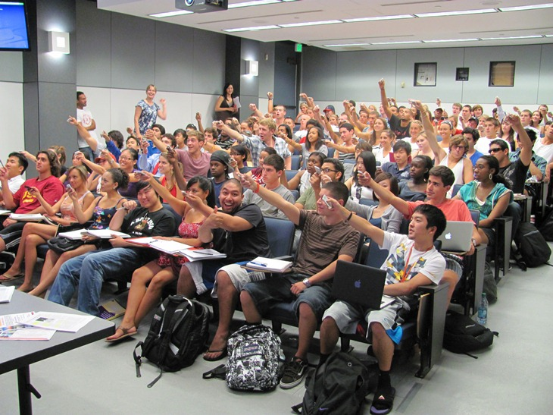
So, how do we raise engagement in a MOOC?
http://cst.usc.edu/blog/beyond_clickers_-_polling_tech.html

Slide 15
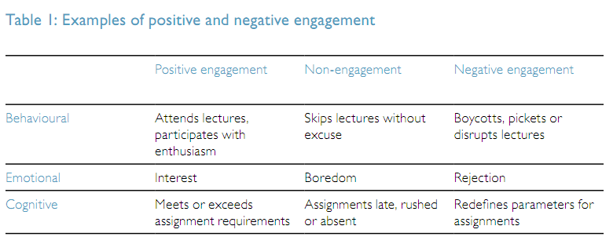
Engagement can be a “a broad construct” fostering active and collaborative learning....
Vicki Trowler – Engagement Literature Review http://bit.ly/sQfdXL
Notes:
Vicki Trowler, Student Engagement Literature Review
"Coates (2007, 122) describes engagement as “a broad construct intended to
encompass salient academic as well as certain non-academic aspects of the student
experience”, comprising the following:
- active and collaborative learning;
- participation in challenging academic activities;
- formative communication with academic staff;
- involvement in enriching educational experiences;
- feeling legitimated and supported by university learning communities."
See also: Examples of positive and negative engagement (p.6)

Slide 16
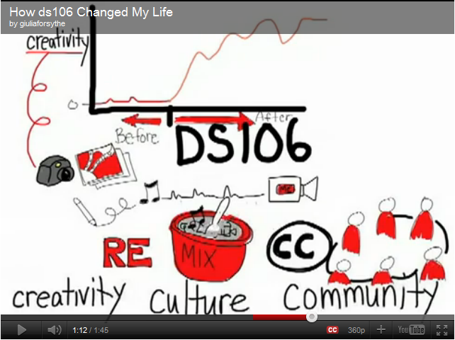
Online engagement can be life-changing
http://gforsythe.ca/topics/openlearning/ds106-openlearning/

Slide 17

What is it though? Most of the research... has concentrated on the simple measure of attendance (Douglas & Alemanne, 2007).
http://beerc.wordpress.com/2010/03/09/online-student-engagement/
Photo: http://bit.ly/us0Joe

Slide 18
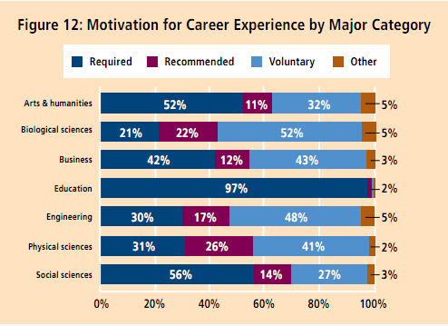
But, on-campus engagement may be very different from online engagement
NSSE Engagement Report http://bit.ly/vFAi2V
Notes:
Typical types of engagement, from this report:
- conversation with faculty
- taking notes / reading notes
- collaboration
- serious conversations
Also – high impact engagement – “may be lifechanging” -- *that’s* what we want in a MOOC

Slide 19
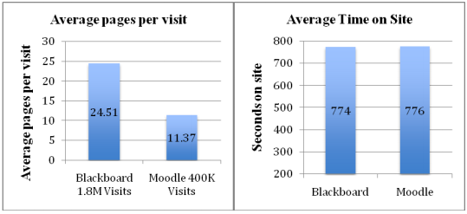
In the online world, this translates into counting page hits or time on the LMS
http://www.ascilite.org.au/conferences/sydney10/procs/Beer-full.pdf
Notes:
From Col - see also Beer, Clark, Jones, Indicators of Engagement, which has much of the same content
Most of the research into measuring student engagement prior to the widespread adoption of online, or web based classes, has concentrated on the simple measure of attendance (Douglas &amp; Alemanne, 2007). "Stovall (2003) suggests that engagement is defined by a combination of students’ time on task and their willingness to participate in activities. Krause and Coates (2008) say that engagement is the quality of effort students themselves devote to educationally purposeful activities that contribute directly to desired outcomes."
"Additionally, Chen, Gonyea and Kuh (2008) say that engagement is the degree to which learners are engaged with their educational activities and that engagement is positively linked to a host of desired outcomes, including high grades, student satisfaction, and perseverance. Other studies define engagement in terms of interest, effort, motivation, time-on-task and suggest that there is a causal relationship between engaged time, that is, the period of time in which students are completely focused on and participating in the learning task, and academic achievement (Bulger et al., 2008)."
"A basic tenet of the research into engagement is that students’ activity, involvement and effort in their learning tasks is related to their academic achievement. While there does not appear to be a single definition for engagement, the following definition represents an aggregation of the literature. Engagement is seen to comprise active and collaborative learning, participation in challenging academic activities, formative communication with academic staff, involvement in enriching educational experiences, and feeling legitimated and supported by university learning communities (Coates, 2007, p. 122)."

Slide 20

We can force attendance by measuring attendance, but we want something deeper

Slide 21

What about engagement as relevance – the idea that people choose their learning?
http://vimeo.com/9216308
Notes:
Esther Wojcicki: Student Engagement is Key
- why do students drop out? because they don't see the curriculum as relevant
- what skills are relevant? 21st century skills - blogging, reading ads
- need to get school districts to change - students are in 'airplane mode' - students need input, education that serves their interests
- need creative teachers

Slide 22
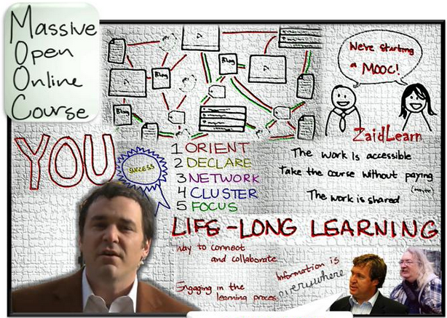
But the presumption of a MOOC is that participants have self-selected, that they're already interested and motivated.
http://bit.ly/uBXovH

Slide 23

Engagement as the fostering of activities
http://bit.ly/suyUVJ
Notes:
Teacher Tube - What is Student Engagement?
- 10 seconds - multiplication rap
- students choose field, become experts in the field, then they teach the other students
- 1:50 - nice definition - looking, thinking, engaging, talking... "doing something"
- think-pair-share, looking at test results &amp; evaluating errors, peer editing, we choose what we measure...

Slide 24

Perhaps we can take lessons in engagement from games and game design?
http://www.ted.com/talks/gabe_zichermann_how_games_make_kids_smarter.html
Notes:
TED, Gabe Zichermann: How games make kids smarter
Game Thinking - game mechanisms to engage audiences
- speed camera lottery (11:00 or so)
Features:
- faster pace
- rewards everywhere
- extensive collaborative play
- global world

Slide 25

But where is the challenge in a MOOC? Where is the possibility of failure?

